Slide 1
overall_0_132367198033335501 columns_1_132367198033335501
Climate and Mode Shift
Mary Nicol, Director of Policy, Chicago Department of Transportation
January 25, 2023

Slide 2
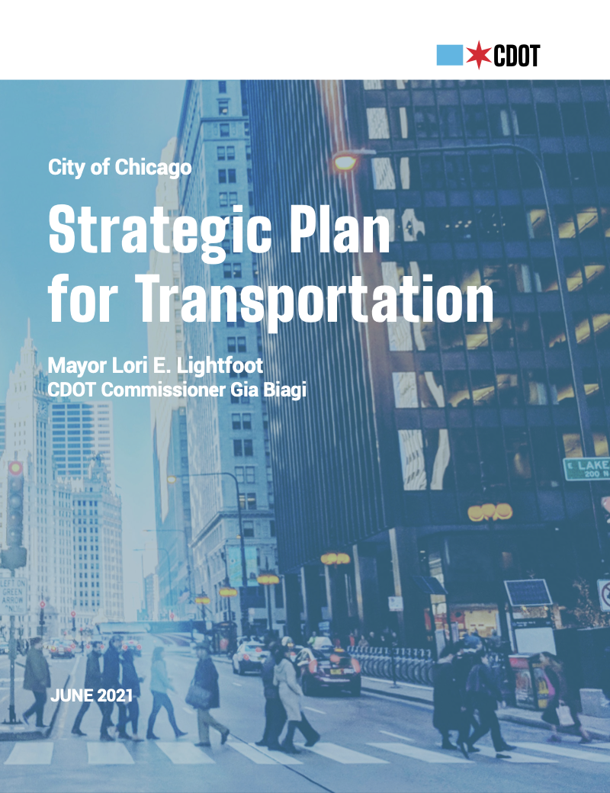
Commitment to Mobility Justice
overall_1_132617824266177474 columns_1_132617824266177474
CDOT’s 2021 Strategic Plan for Transportation is the nation’s 1st agency plan to declare a commitment to mobility justice.
“We are advocating for CDOT to establish a comprehensive process and strategy to remove racialized transportation inequities…. We want a transportation system in Chicago which does not require car ownership.”
– Transportation Equity Network

Slide 3
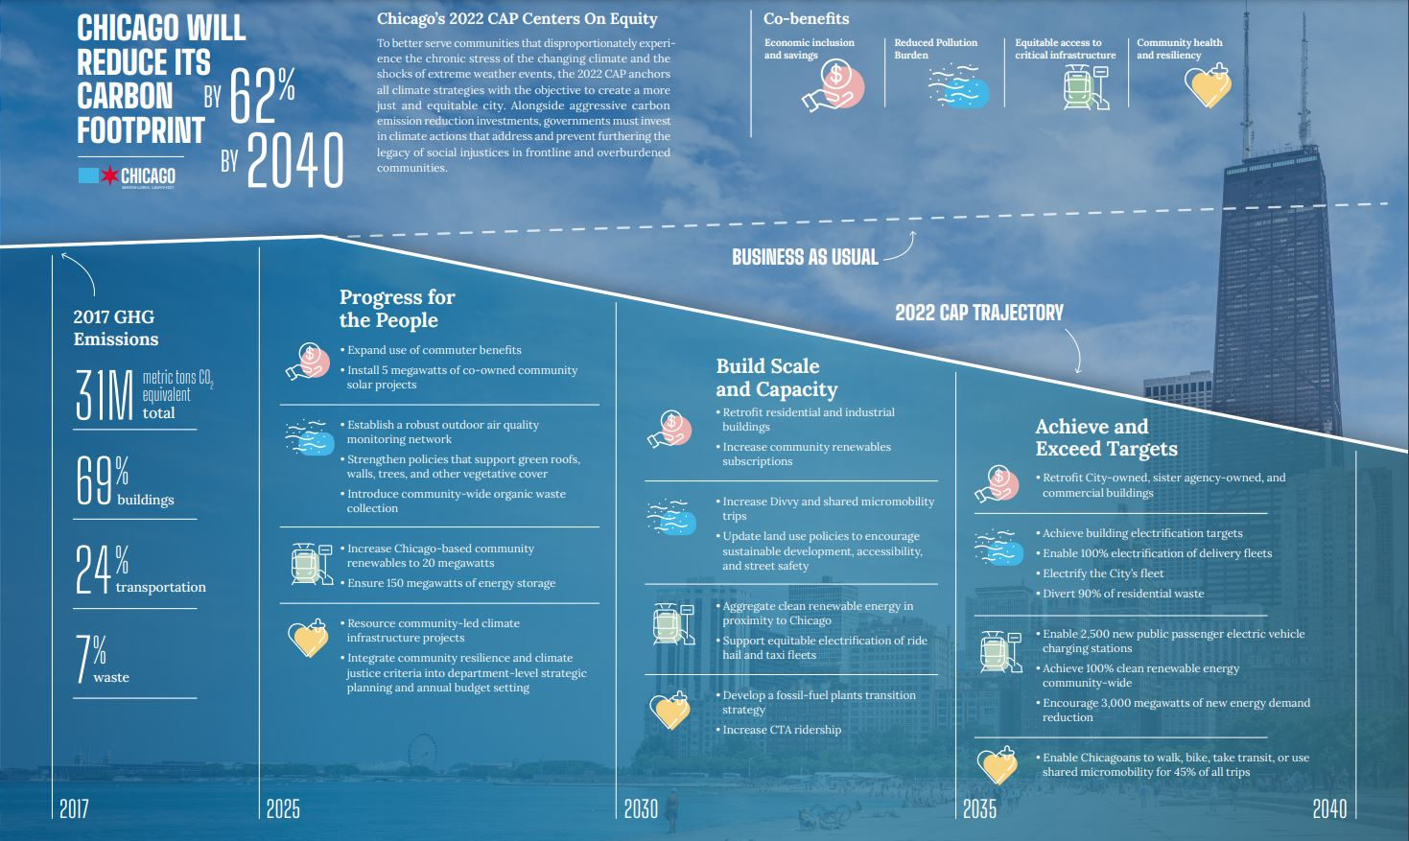
overall_1_132617861608743146 columns_1_132617861608743146

Slide 4
Actions
overall_1_132617824257746452 columns_1_132617824257746452
Enable Chicagoans to walk, bike, take transit or use shared micromobility for 45% of all trips by 2040
Increase Divvy bikes and shared micromobility trips 30% by 2030
Expand high quality and low stress on street bikeways and off-street trails

Slide 5
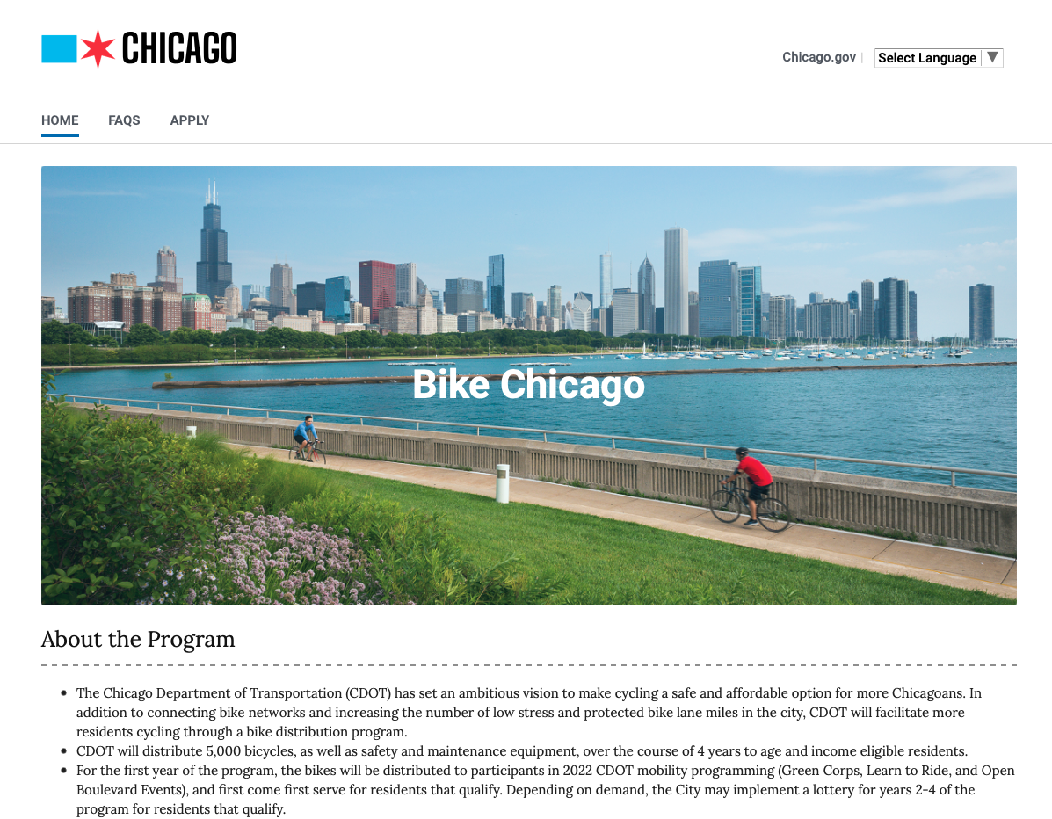
The Bike Chicago Program
overall_1_132617824273050924 columns_1_132617824273050924
Affordable & low-carbon mobility
Provide 5,000 free bikes and safety equipment to Chicagoans by 2026
Over the course of 4 months in 2022, CDOT distributed 500 bikes to residents
Eligibility
Residents 14 & older; AND
Household income at or below AMI; AND
Do not already own a bicycle; AND
Residents that face higher mobility hardship; OR
Participants in CDOT 2022 mobility programming (Green Corps, Learn to Ride, and Open Boulevard Events)
www.chicago.gov/bikechicago

Slide 6
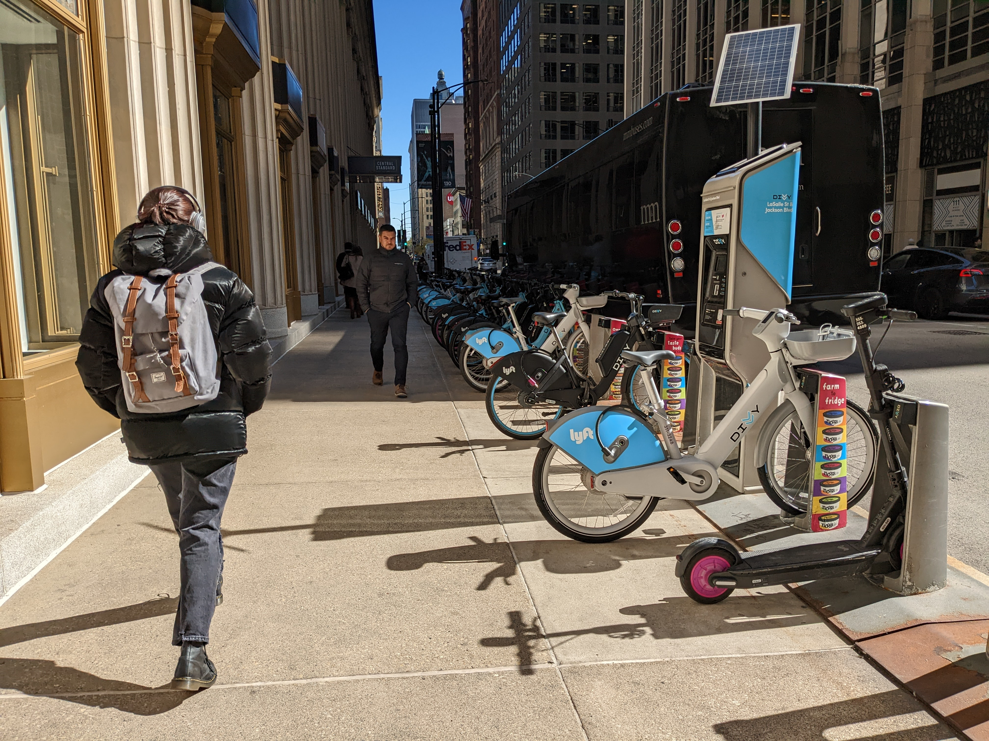
Docked Bikes AND Scooters
overall_1_132617824266177474 columns_1_132617824266177474
“I am a father of four children. I often am asked by my kids to ride with them. I usually walk with them and receiving a bike will make it so much fun to ride along with them. They will be so excited to see me ride with them.”
– Bike Chicago Applicant

Slide 7
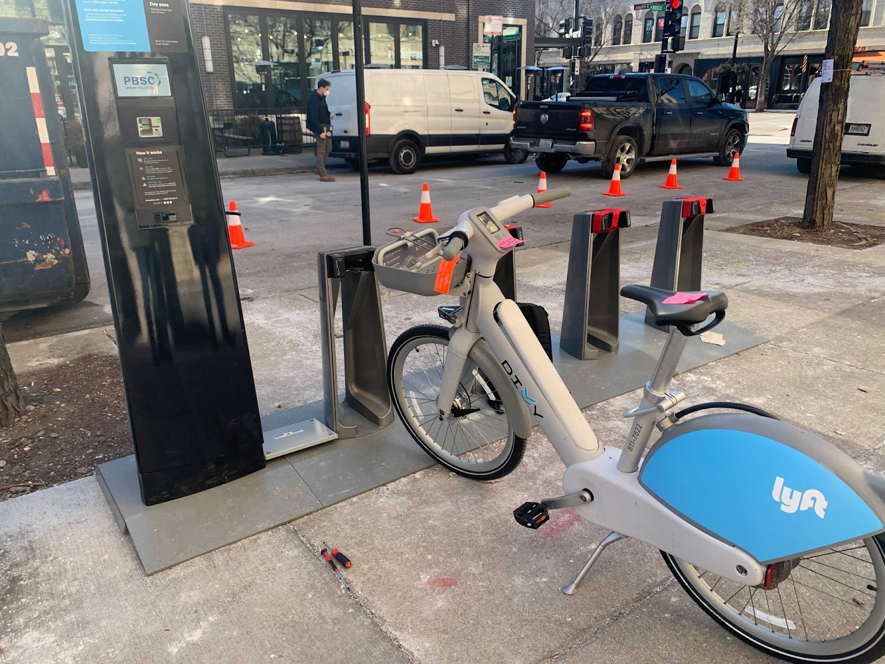
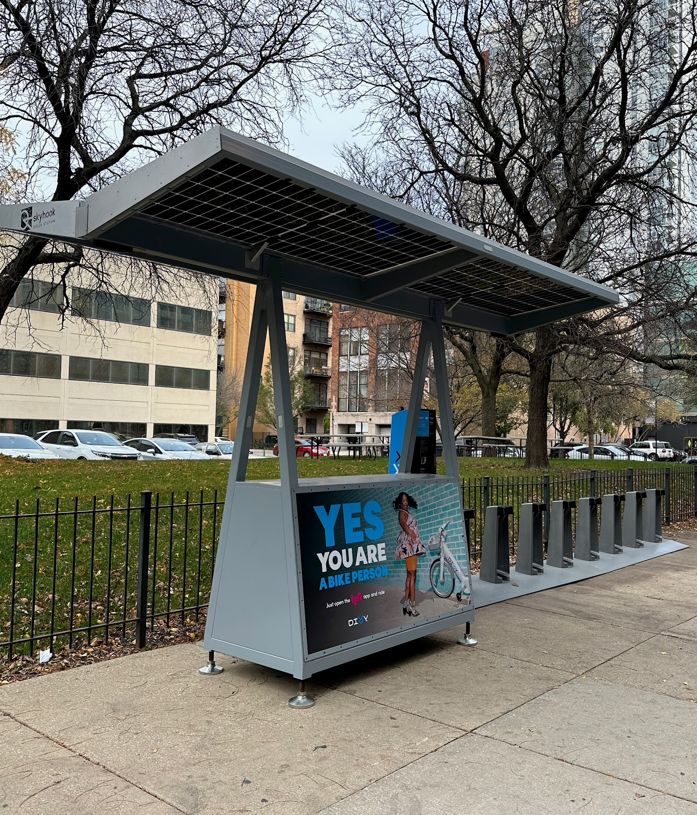
Greening Operations
overall_1_132617824277843185 columns_1_132617824277843185
Mobility and Economic​ Hardship Index
8
7
6
9
10
Station Electrification
Solar Charging

Slide 8
Appendix
overall_1_132617824283223530 columns_1_132617824283223530

Slide 9
Bike Chicago demand exceeded expectations
overall_1_132617824277843185 columns_1_132617824277843185
Almost 20,000 applications in the first year (more than 14,000 applications in the first week alone)
Ages 30-40 (26%); 50+(21%)
Exercise, Fun/Stress relief, and Transportation were the top three reasons applicants wanted a bike.

Slide 10
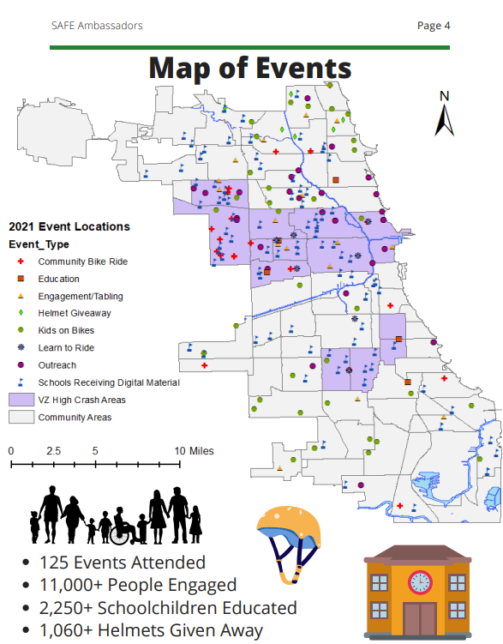
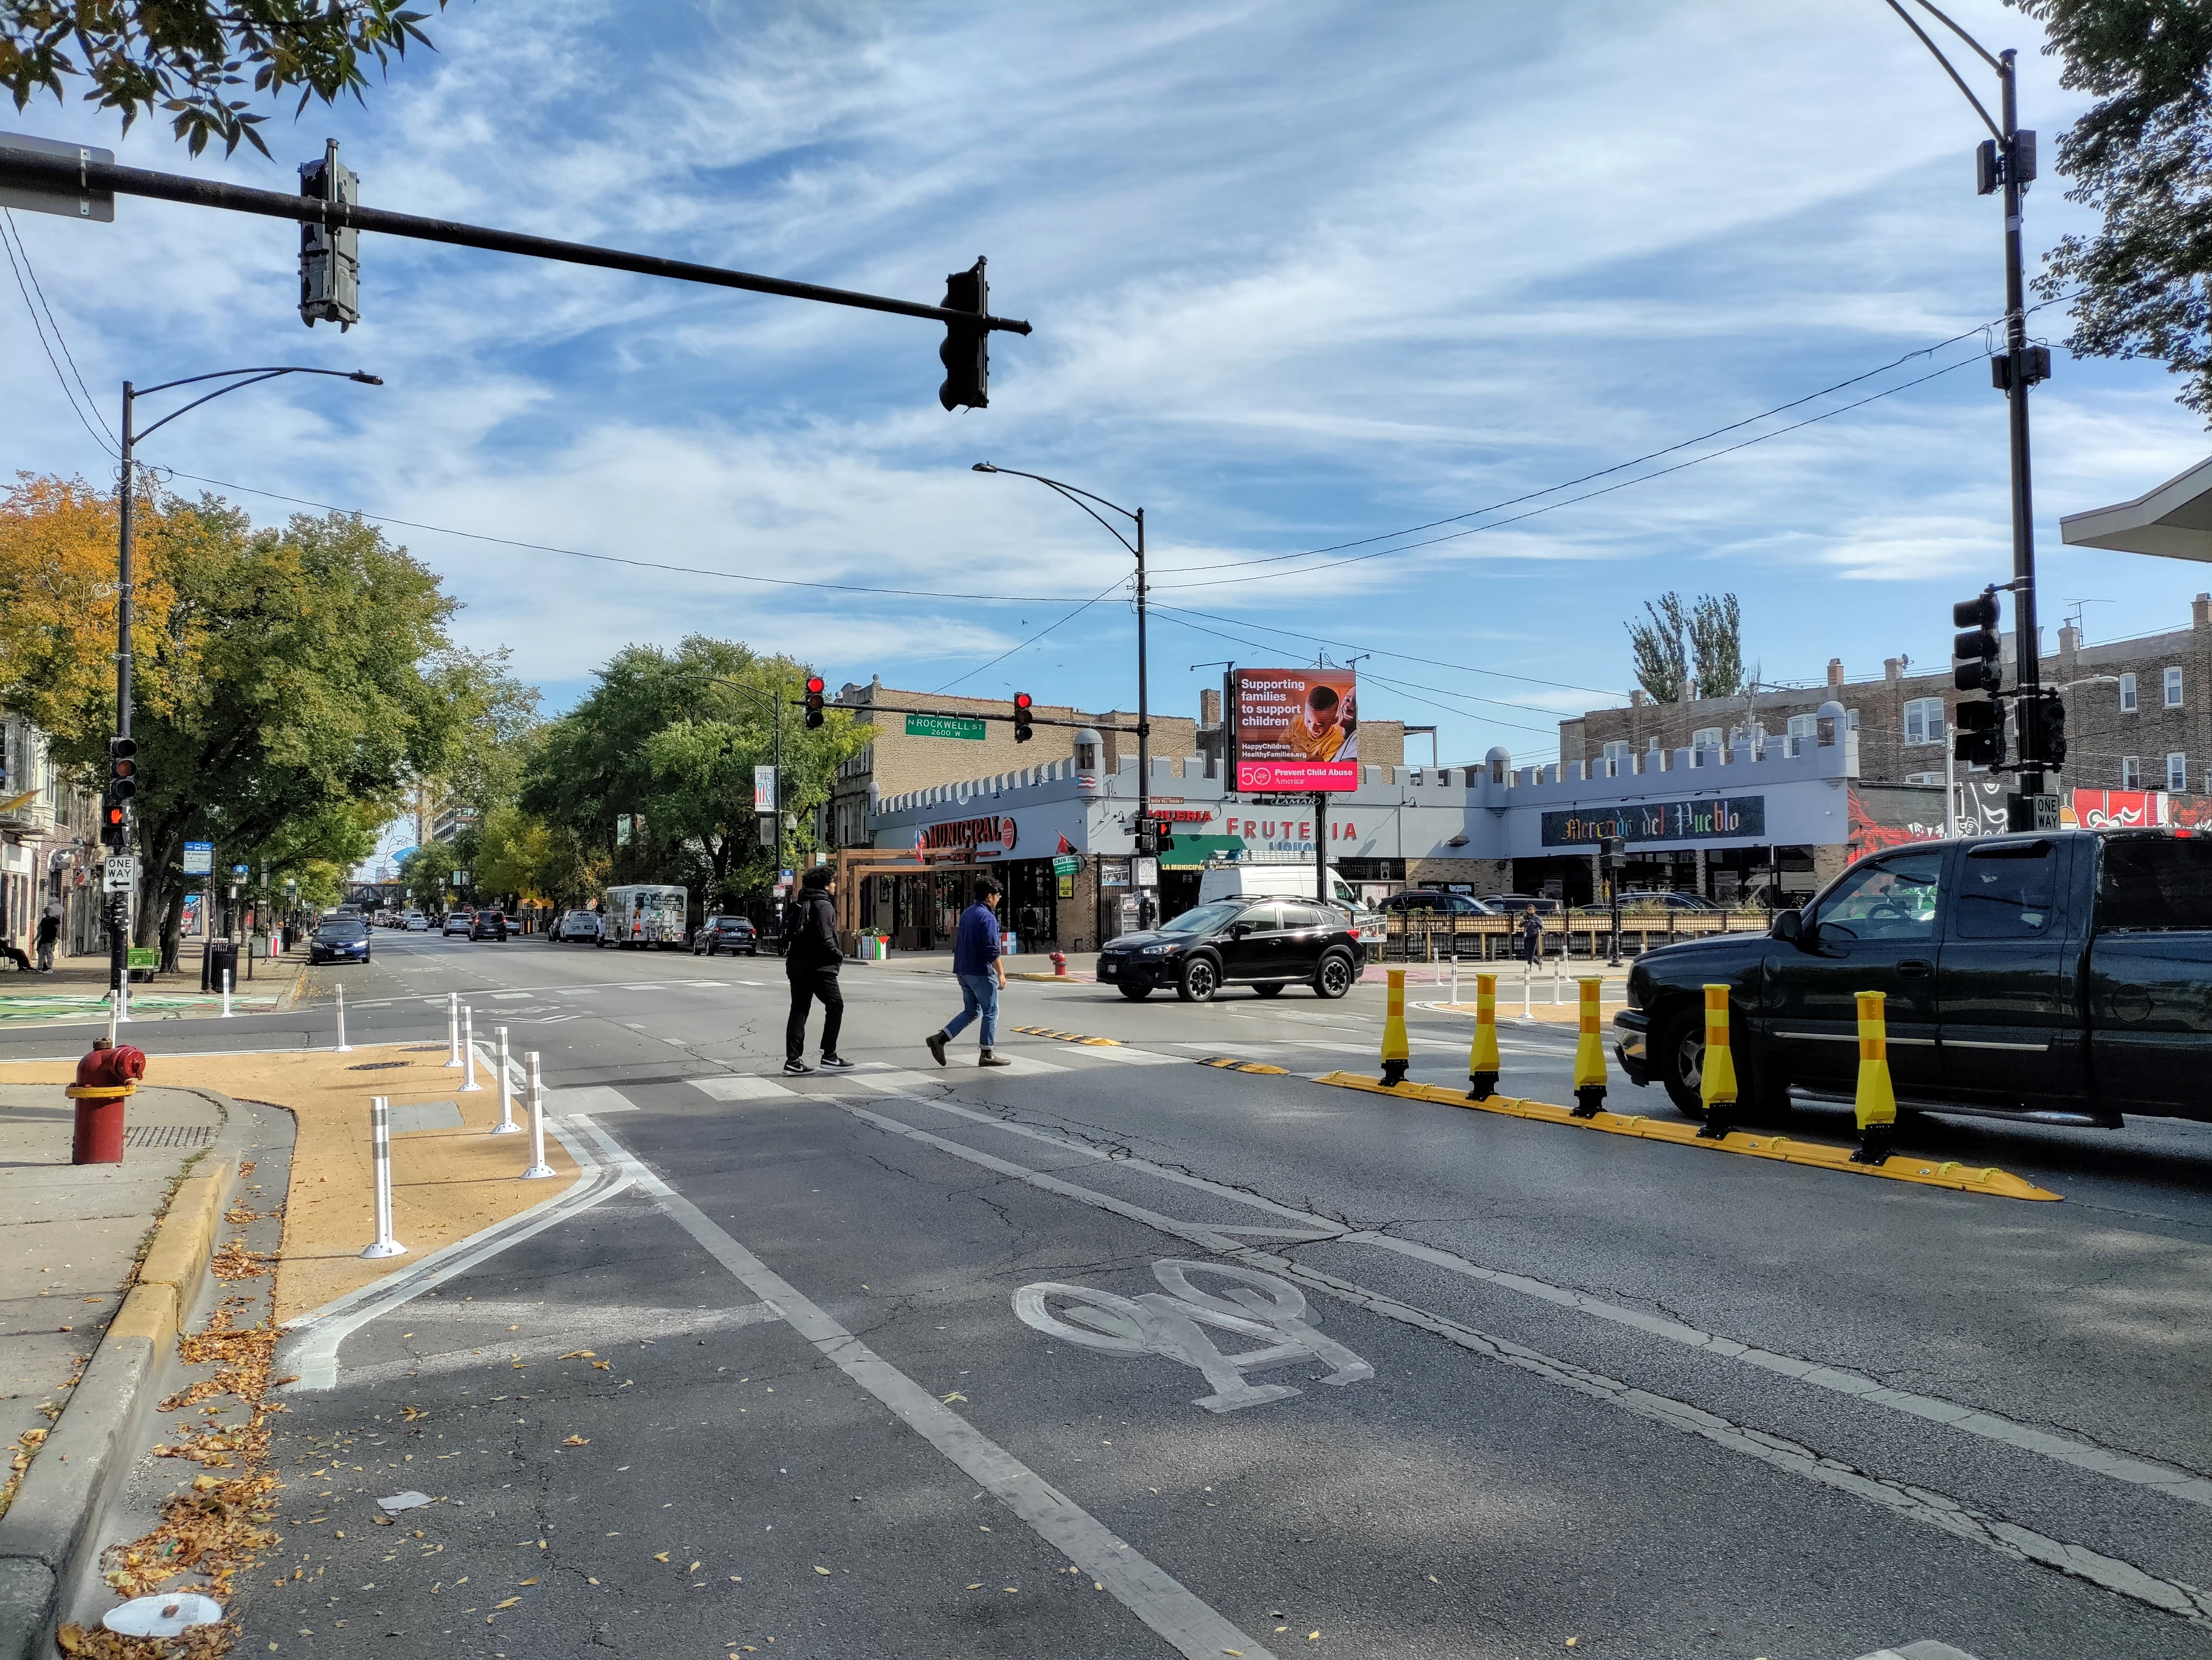
Safety Investments
Education
Bikeways
Intersections
Low Stress Bikeways: More low stress bikeways installed in 2021& 2022 than previous years.
Network Expansion: Doubled the rate of bikeways installed per year. Total 429 mi of bikeways in the city in 2022, of which 85 miles are low stress routes.
Closing Gaps: On track to fill 15 miles of network gaps
Pedestrian safety improvements installed at over 400 intersections in 2022.

