Slide 1
Denver’s E-bike Voucher Program and Micromobility Ecosystem
Shared Use Mobility Center
January 25, 2023
Mike Salisbury
Transportation Energy Lead
Mike.salisbury@denvergov.org
Notes:
Thanks for that introduction, thanks for inviting me to be here today.

Slide 2
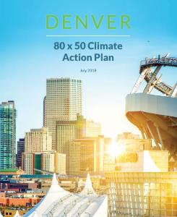
The Office of Climate Action, Sustainability, and Resiliency (CASR) is responsible for rapidly and equitably decarbonizing Denver
2018 commitment from the Mayor
2021 updated City commitment
Reduce GHG emissions 80% by 2050 from 2005 baseline
Reduce GHG emissions 65% by 2030 from 2019 baseline and 100% by 2040
Notes:
Mayor Michael Hancock and the Denver City Council created the Office of Climate Action, Sustainability, and Resiliency (CASR) in 2020 to manage the City's ambitious emission reduction goals and sustainability programs in collaboration with fellow departments, other units of government, and community partners. The office ensures that the City's targets are aligned with current climate science, promotes the role that climate action and sustainability play in strengthening Denver's economic vitality and a prosperous future for all residents and businesses, and embraces equity as a value and practice in all of its work.
CASR's mission is to:
Act with urgency to proactively mitigate climate change by advancing science-based strategies to reduce greenhouse gas emissions on a scale and timeline that align with the recommendations from the Intergovernmental Panel on Climate Change;
Cultivate resiliency in the face of potential climate change-related emergencies;
Secure an economically, socially, and environmentally sustainable city for generations to come; and
Ensure that the setting of goals and metrics and monitoring of results considers equity

Slide 3
0.25% sales tax with equity exemptions
$40 million annual budget for Climate Action
50% of funding supports equity
Six allowable uses:
Workforce
Renewables
Climate Justice
Adaptation & Resiliency
Transportation
Buildings
Notes:
On November 3, 2020, the people of the City and County of Denver voted in favor of Ballot Initiative 2A, raising the local sales and use tax by 0.25% to create the Climate Protection Fund (CPF). The CPF, which is expected to raise up to $40M per year, is dedicated to eliminating greenhouse gas emissions and air pollution, supporting climate adaptation, and creating new jobs to improve the lives of Denverites, with efforts focused on the communities most harmed by climate change, including low-income households and communities of color. The bill states that the CPF “should, over the long term, endeavor to invest fifty percent (50%) of the dedicated funds directly in the community with a strong lens toward equity, race, and social justice.”
The Climate Protection Fund lists six categories of allowable uses, as follows:
Job creation through local workforce training and new careers for under-resourced individuals in clean energy technology and management of natural resources.
Increased investments in solar power, battery storage, and other renewable energy technology.
Neighborhood-based environmental and climate justice programs.
Adaptation and resiliency programs that help vulnerable communities prepare for a changing climate.
Upgrade the energy efficiency of homes, offices and industry to reduce their carbon footprint, utility bills, and indoor air pollution.
Programs and services that provide affordable, clean, safe and reliable transportation choices, like walking, biking, transit, electric vehicles, and neighborhood-scale transit.

Slide 4
2030 Climate Goal: 65% GHG Reduction
Electrification Goals
30% of registered vehicles
~150,000 electric vehicles
4,000 public charging ports
3,300 Level 2
700 DC Fast Charging
Mobility Goals
Commute Trips:
15% biking and walking
15% transit
50% Single Occupancy Vehicles
Notes:
Below 2019 levels

Slide 5
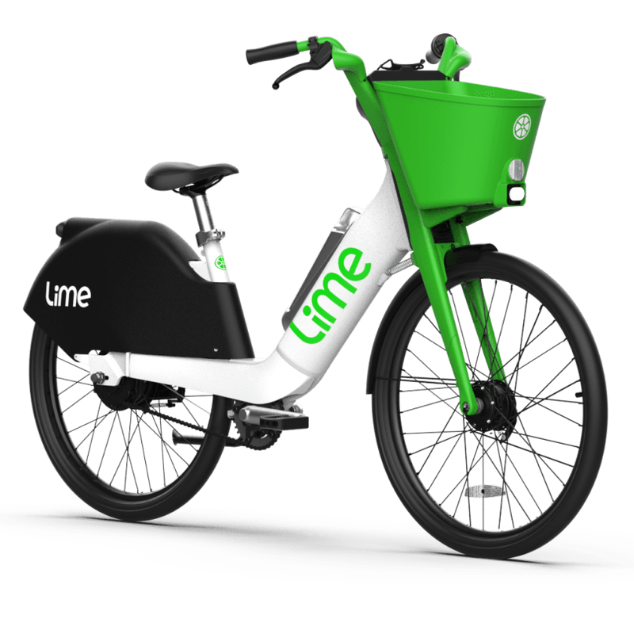
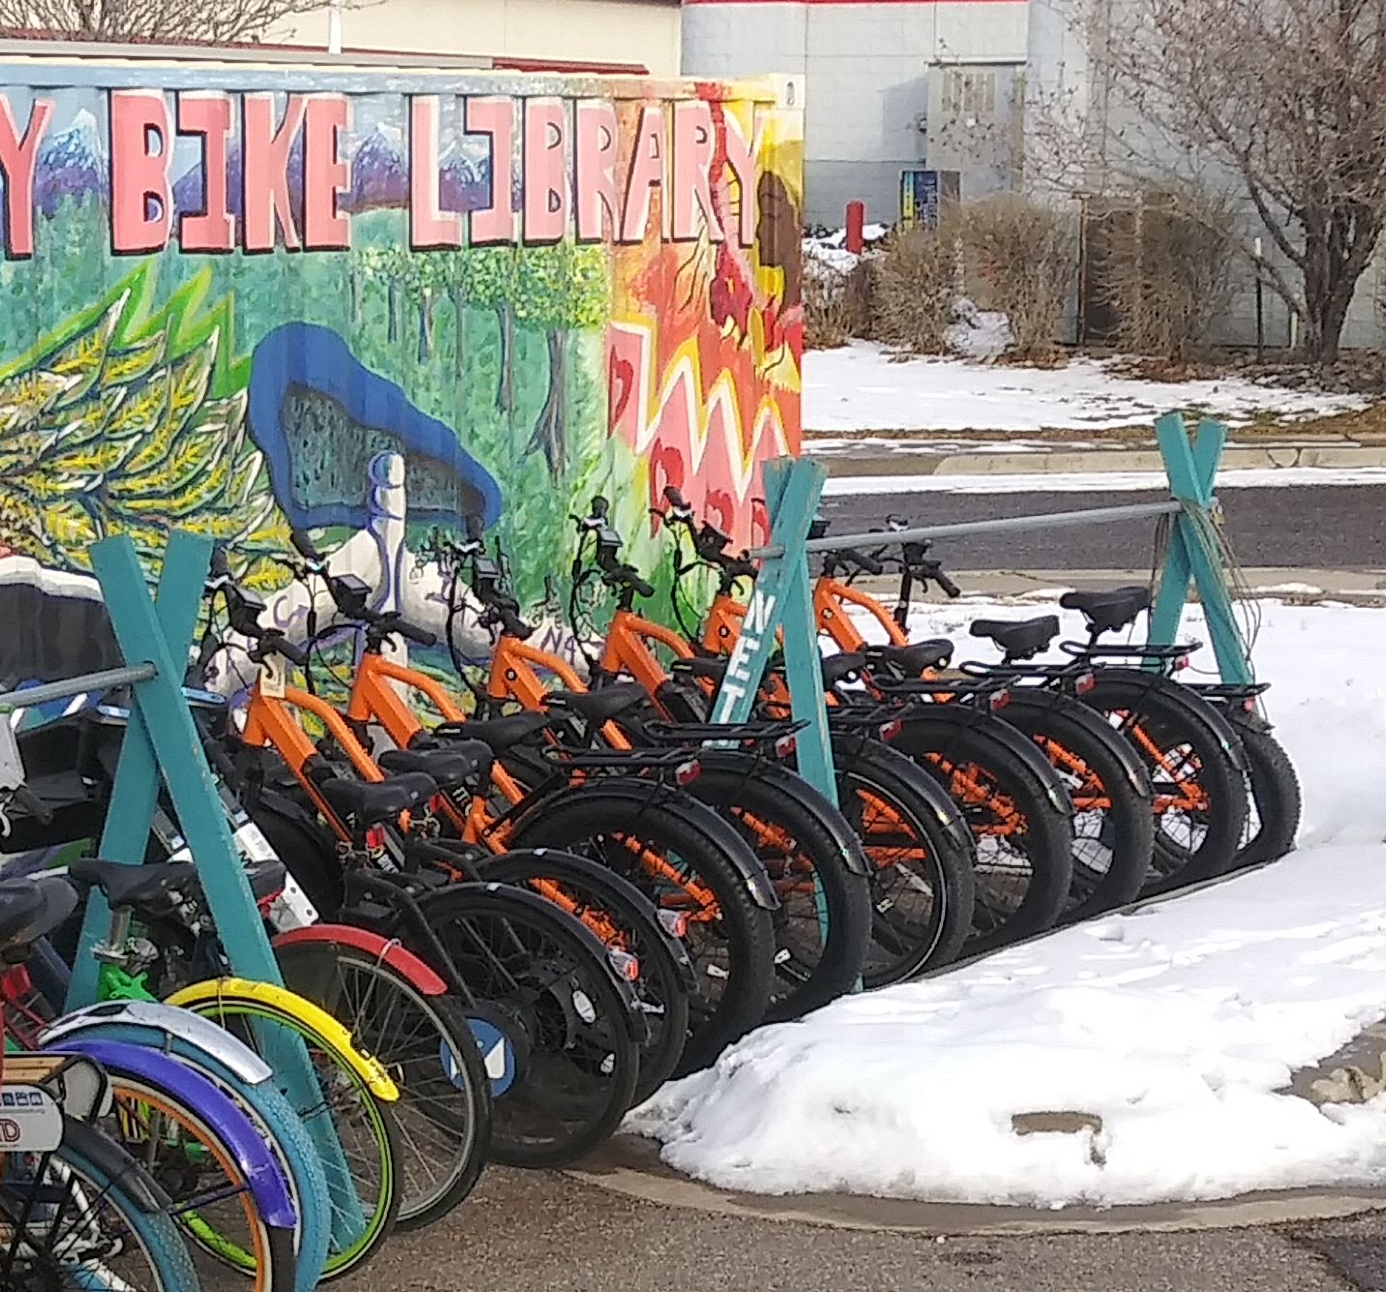
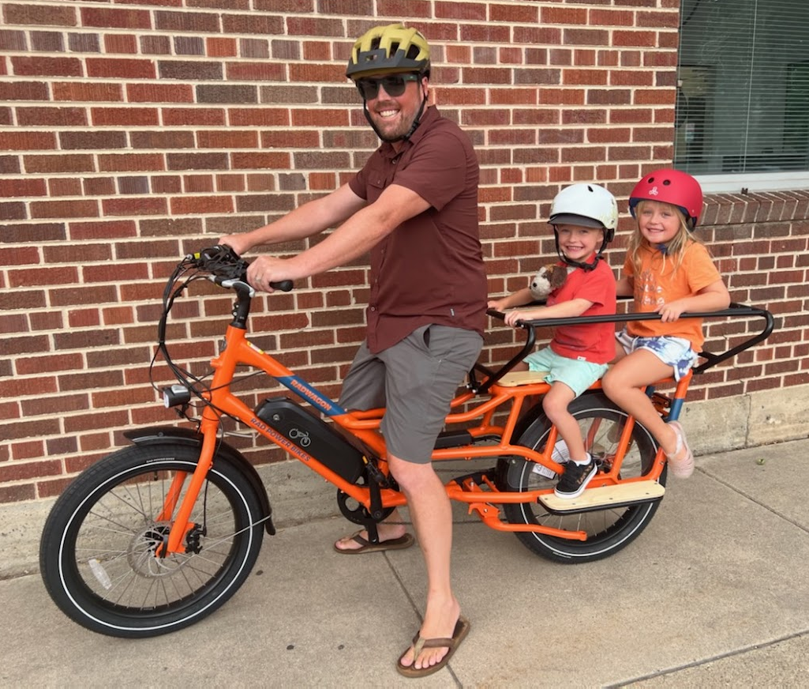
Denver’s Micro-mobility Ecosystem
Shared
E-bike Libraries
Individually Owned

Slide 6
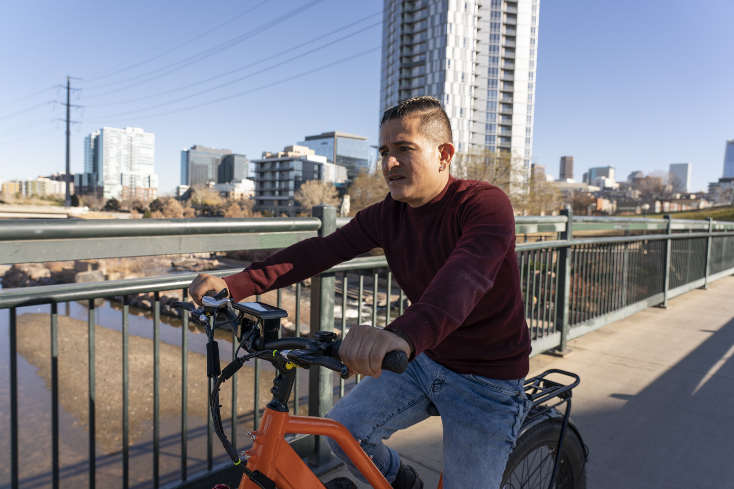
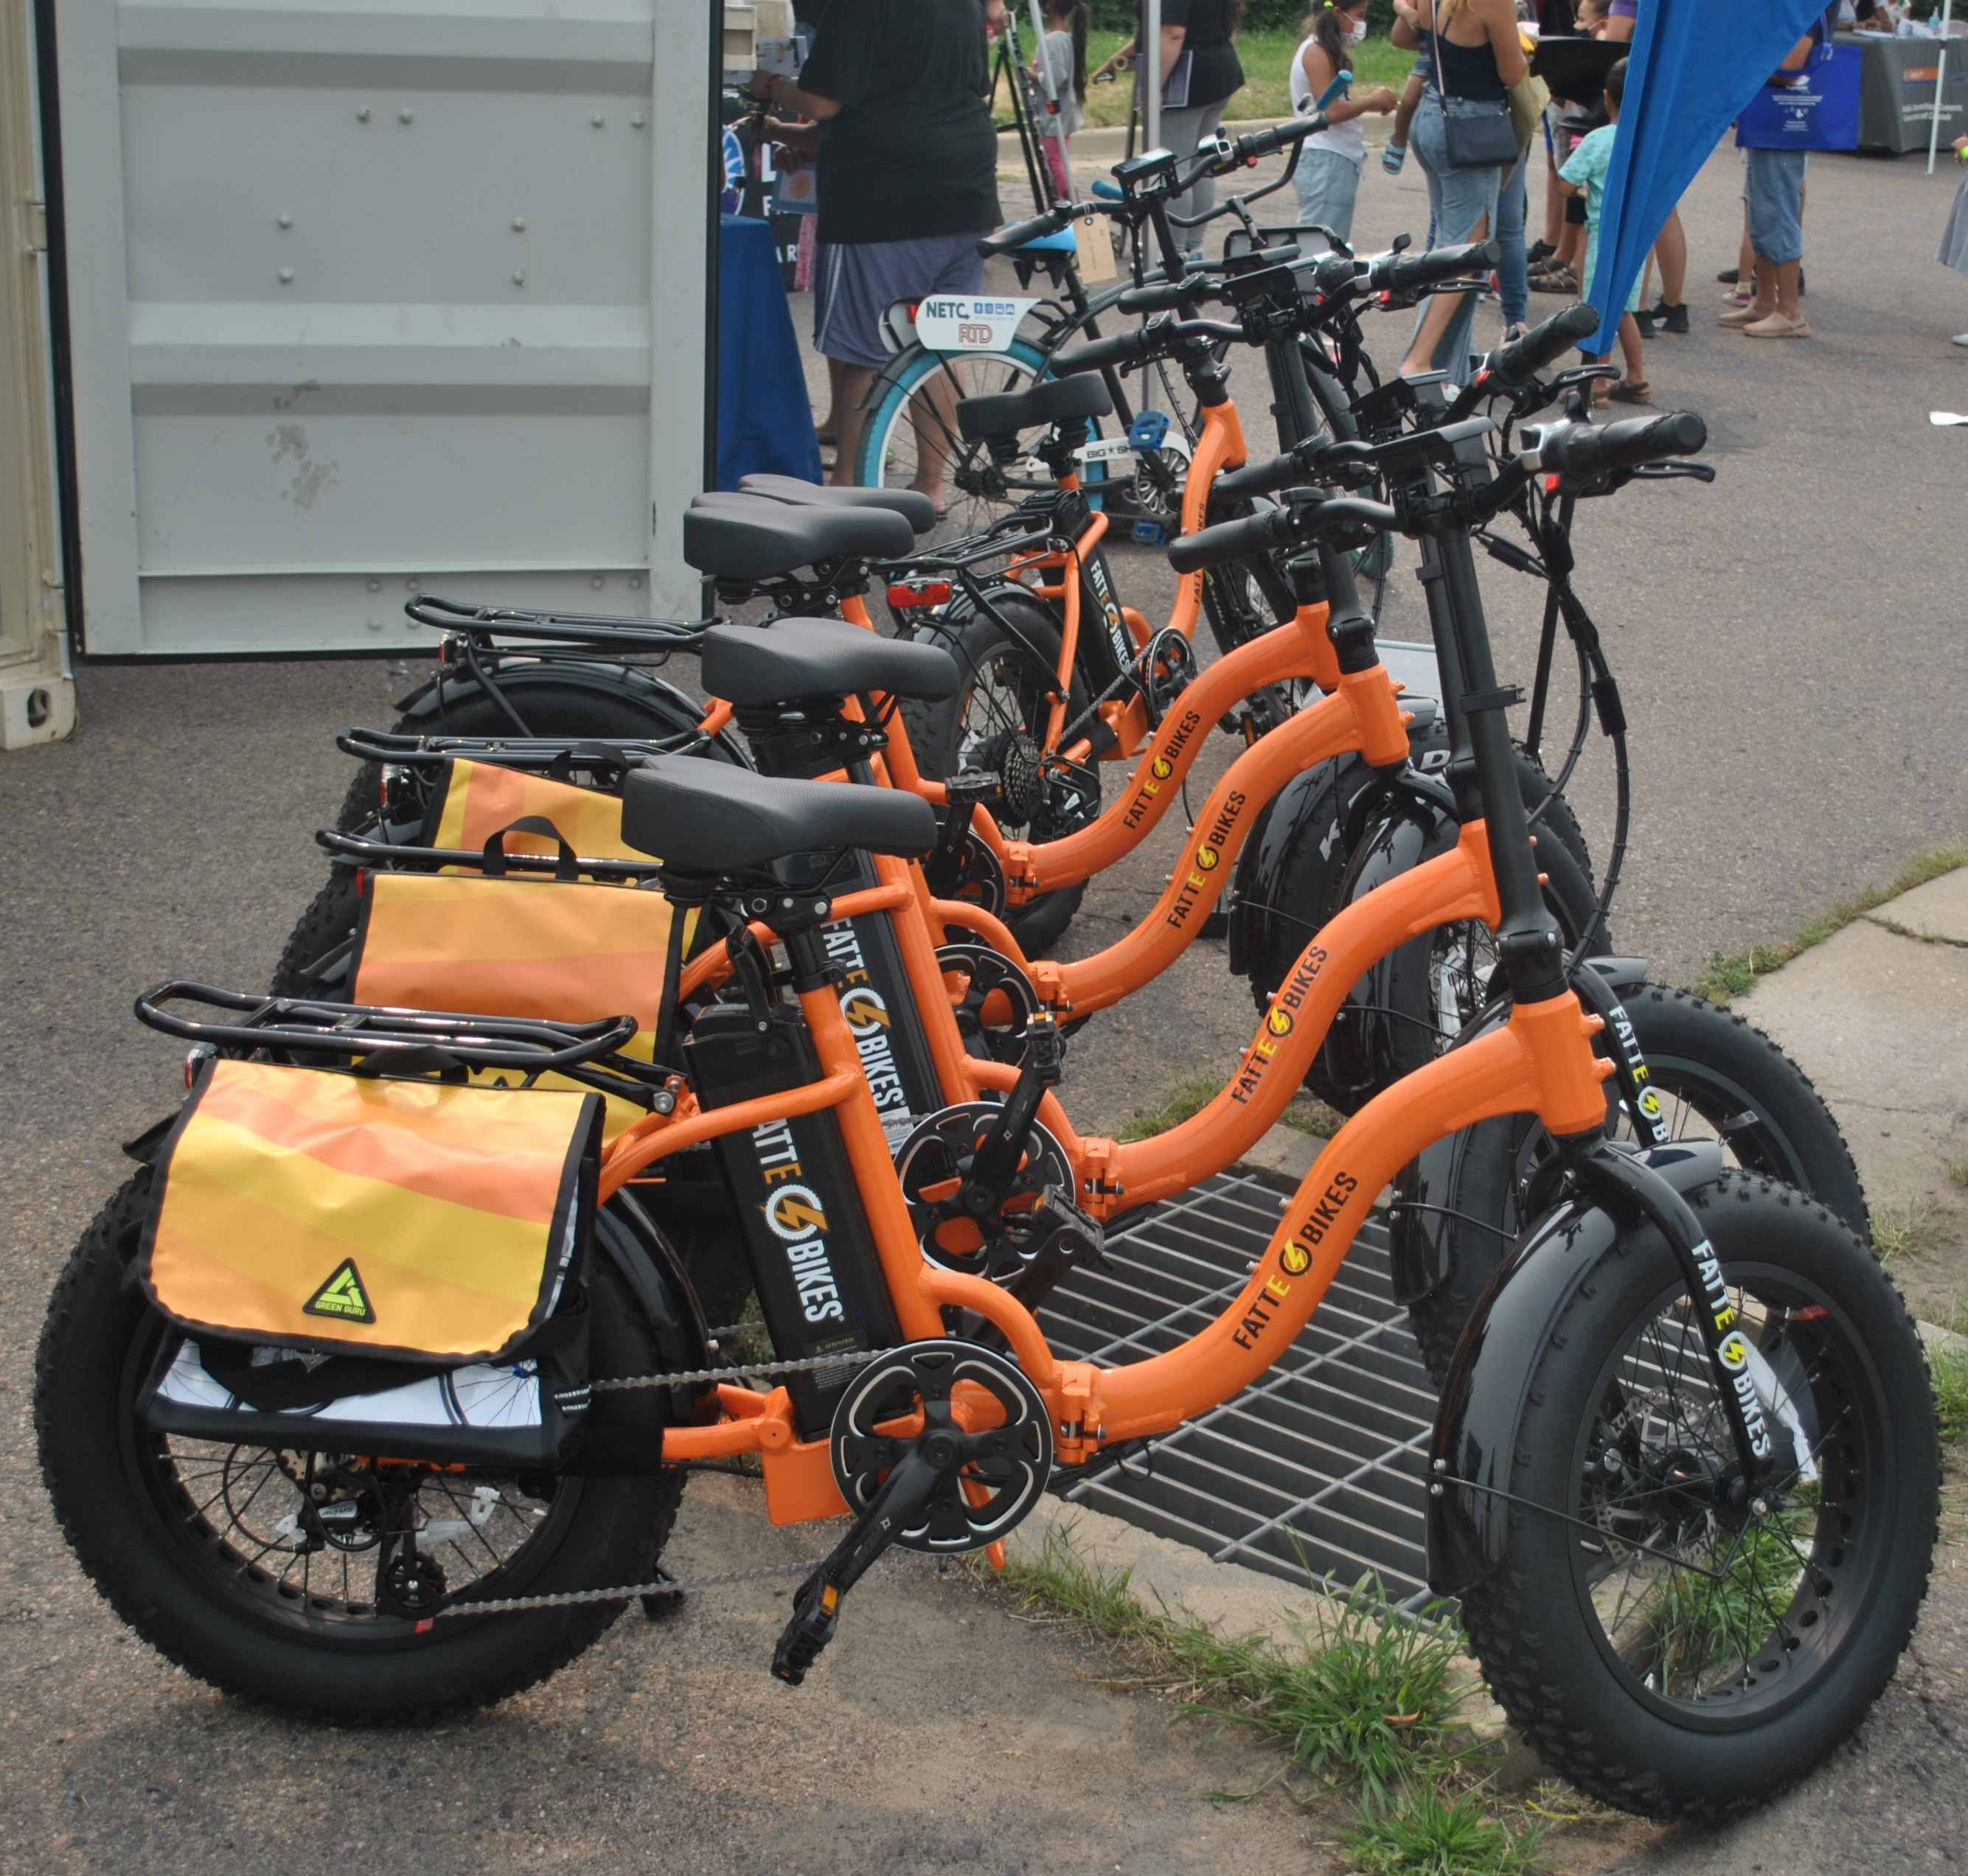
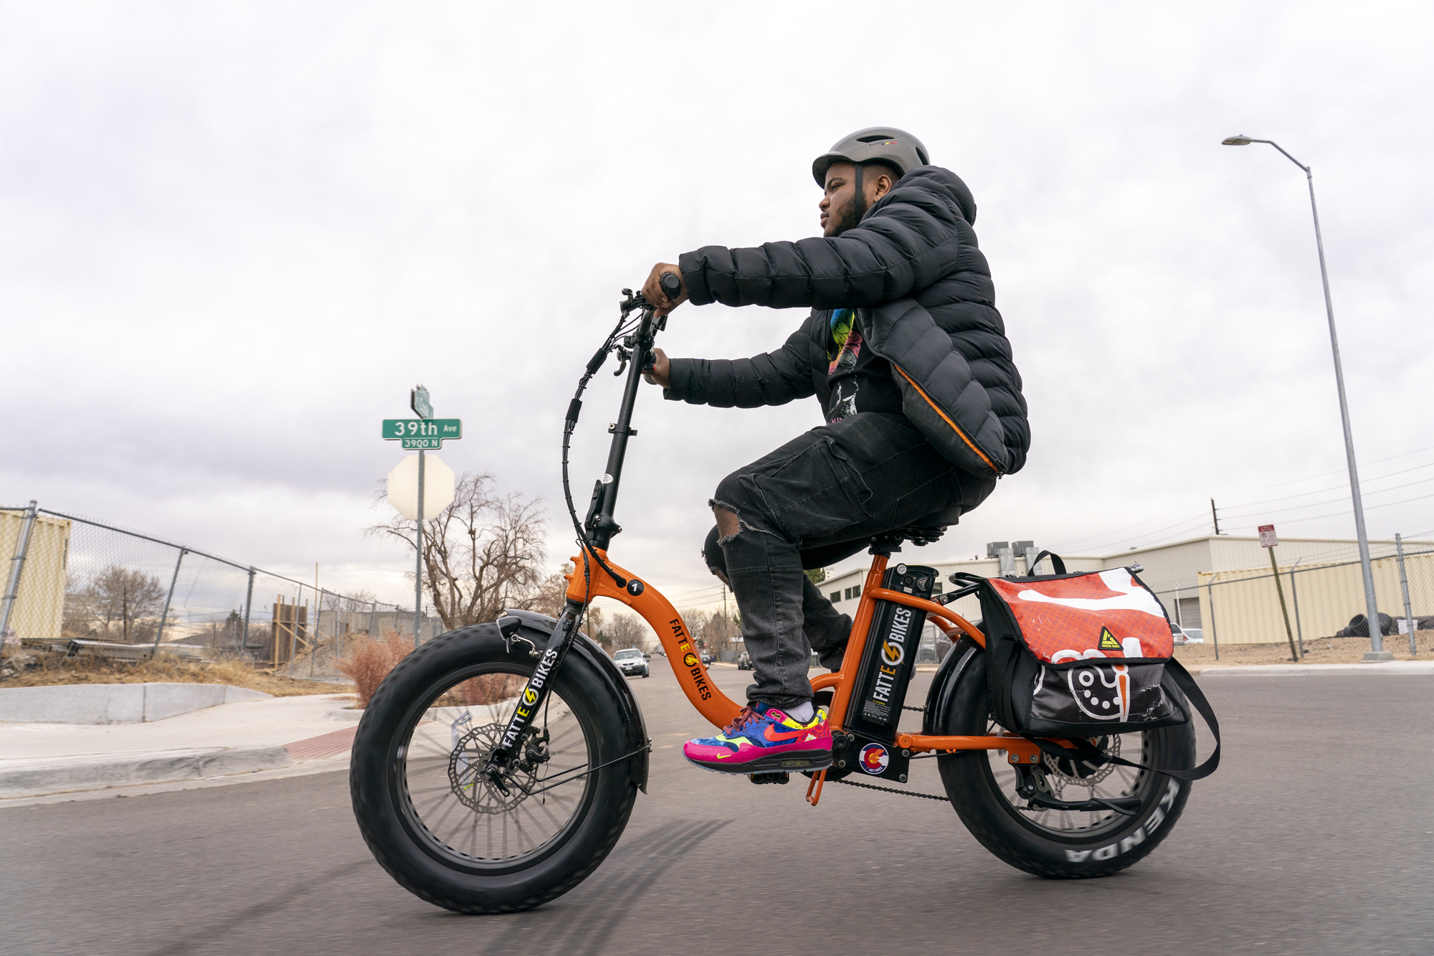
E-bike Libraries 70 E-bikes at 13 locations
Notes:
40 bikes deployed at 10 affordable housing properties
30 bikes deployed at 3 Community based organizations

Slide 7
E-Bike Voucher
Launched Earth Day, 4/22/22
$400 for all Denver residents
$1,200 for income qualified Denver residents
$500 adder for e-cargo bikes
Point of sale rebate
Denvergov.org/ebike
7
Notes:
E-bike rebate program applications and payments are administered by a contracted third-party rebate administrator, APTIM
Application is simple
Keep process simple for residents and bike shops
Started with 9 shops, up to 30+ now

Slide 8
E-bike Vouchers in 2022
9,500+ applications
$4.77 million in vouchers redeemed
$9.34 million in e-bike purchases
4,735 e-bike purchases
2,331 Income Qualified
67% of funding has gone to Income Qualified residents
Average voucher redeemer riding 26 miles and replacing 3.4 vehicle trips per week

Slide 9
Comparing Shared and Individually Owned E-bikes
E-bike Voucher Redemptions
Shared E-bike Riding Density
Notes:
On 8/15/22 there were 2,600 shared e-bike trips that went 4,000 miles. So about 1.5 miles/trip. Owned e-bikes are going about 3.3 miles per trip.
Example of going downtown, creating eco-system where people don’t need cars
Voucher: 71% driving less, 26% less transit, 48% less bike, 32% shared less, 24% walk less

Slide 10
What’s Next?
Program will relaunch on January 31st
Reduction in Standard Voucher from $400 to $300
Reduction in Cargo bike adder from $500 to $200
Applications open every other month

Slide 11
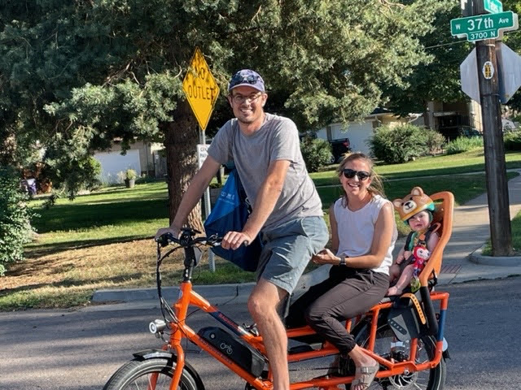
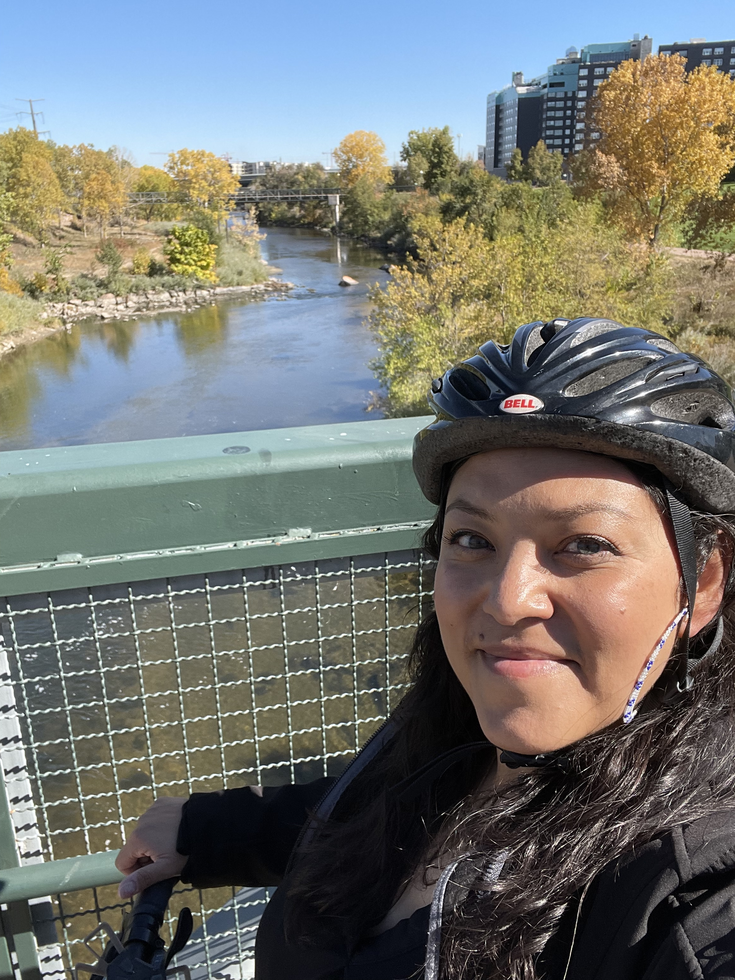
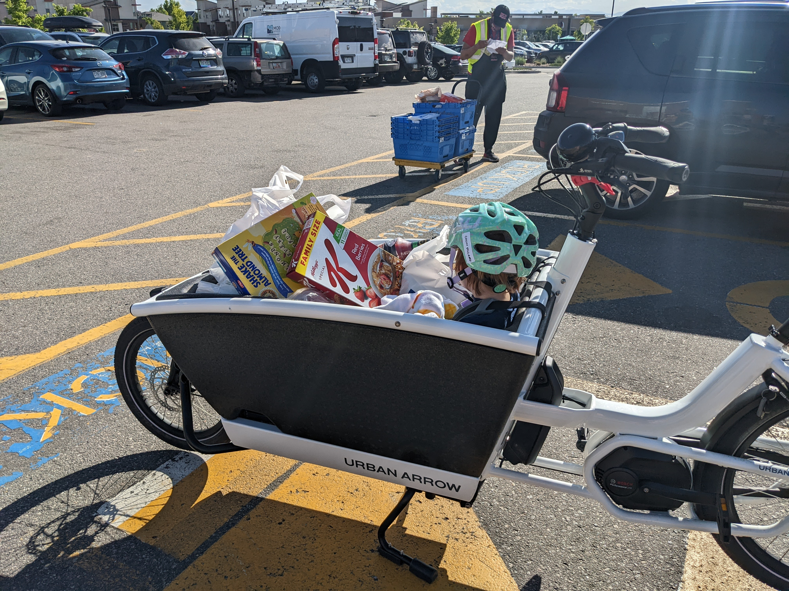
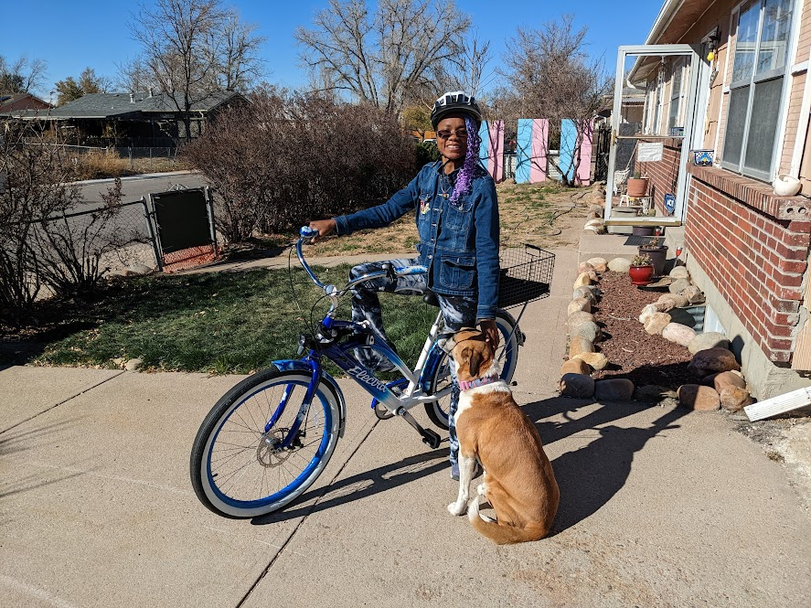
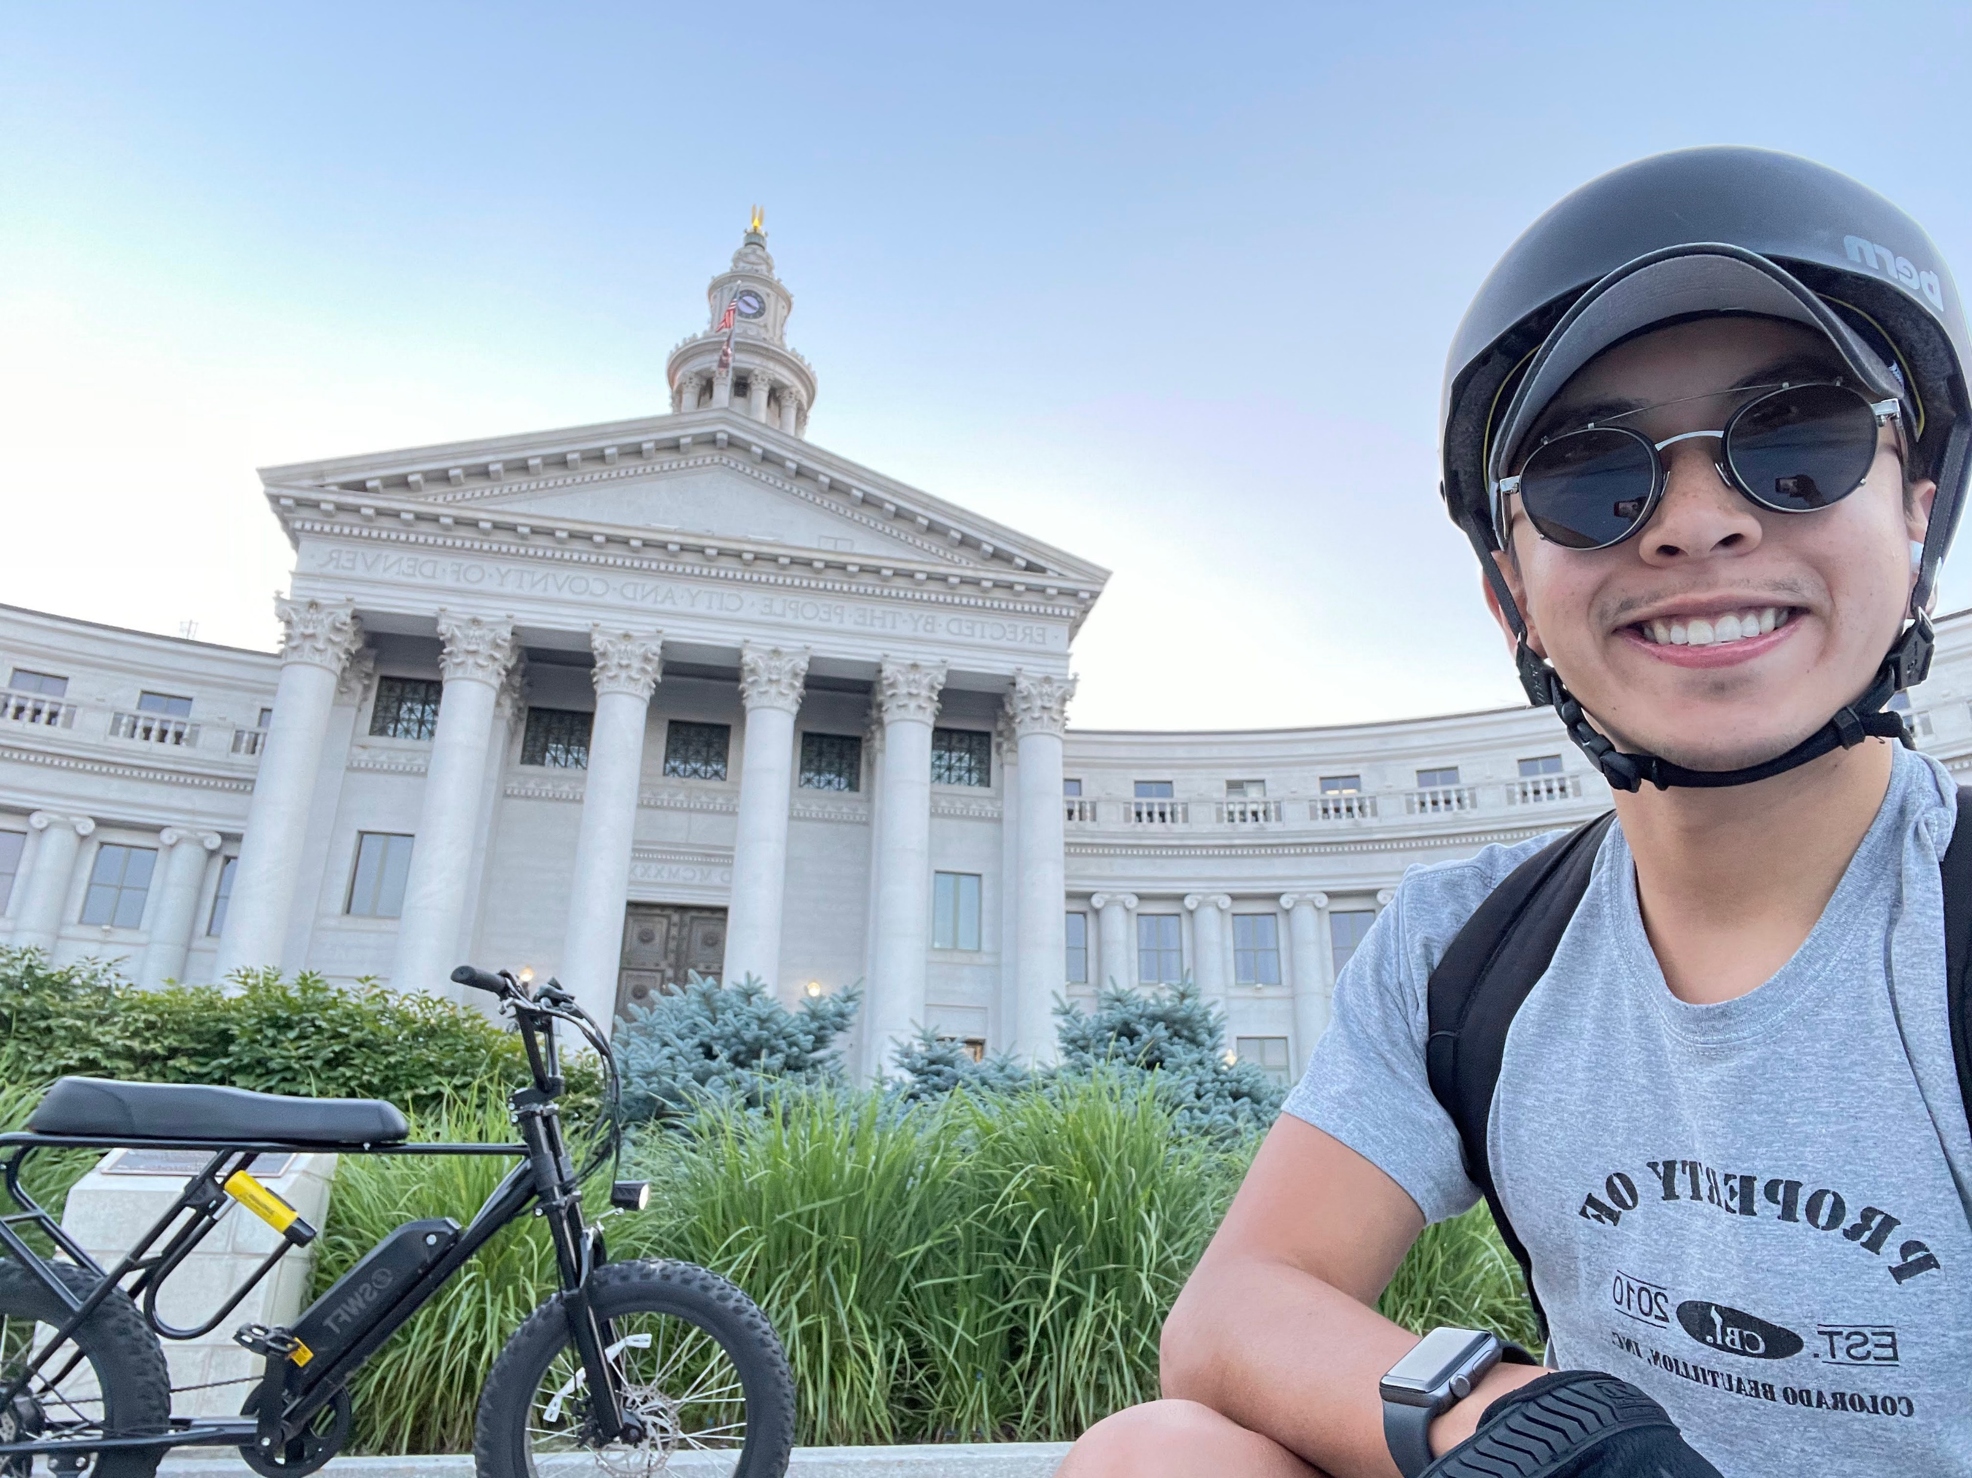
Thank you!

