Slide 1
Micromobility – A Local Climate Strategy in San Diego
Alyssa Muto, Director Sustainability and Mobility Department, City of San Diego
Notes:
Good afternoon, Chair LaCava and members of the Environment Committee.
I am (Name, Pronouns, Title) with the Sustainability and Mobility Department and I am joined here today by _____ and _____.
Background on 2015 CAP
First legally binding CAP in the region
Established goal of reducing emissions by 50% of the baseline in 2030.
Unanimously adopted by the City Council
Talking today about the update to the CAP and new, more ambitious yet attainable goal.

Slide 2
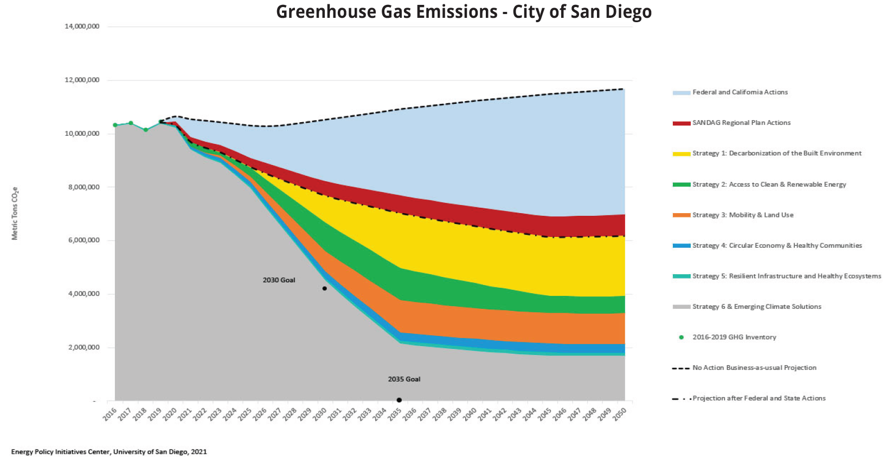
Climate Action Plan Update
Net Zero GHG Emissions by 2035
Prioritizes action in Communities of Concern
Connects to co-benefits of clean air and job growth
Mode Shift to 50% of All Trips to Transit, Bike, Walk and Other Mobility
Buildings and Natural Gas
Mobile Sources
Adopted in August 2022
Notes:
Our 2022 climate action plan sets a net zero greenhouse gas emissions goal for 2035.
We have also set an interim 2030 goal to achieve our fair share of reductions, solidifying the City’s commitment to joining the global effort to address climate change.
Robust community input has laid the foundation for this plan, we have heard from over 4,000 residents throughout our engagement, their voices are reflected through our choices for actions and how we prioritized the core benefits of climate action like air quality and green jobs.
We used an assessment tool to analyze the feasibility & potential for equitable impact of every action as well as how it would impact the daily lives of San Diegans. This works builds the foundation for implementation.
Lastly, this update to the CAP will maintain the CEQA streamlining process that has been a part of the City’s CAP since 2015.

Slide 3
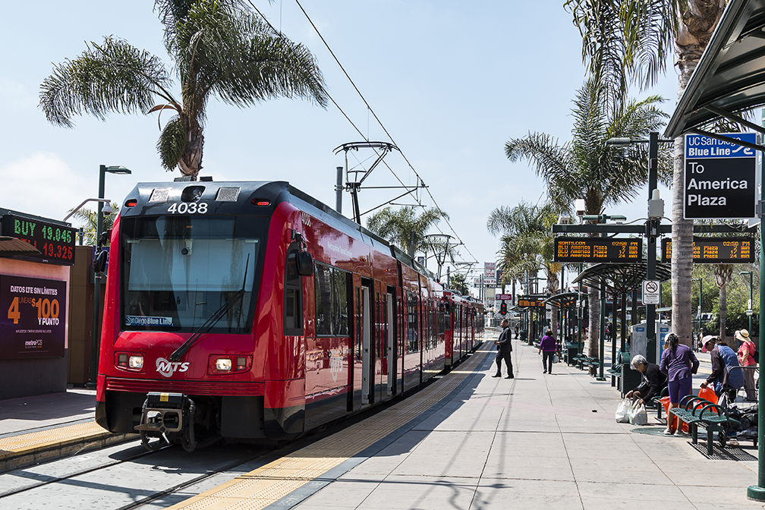
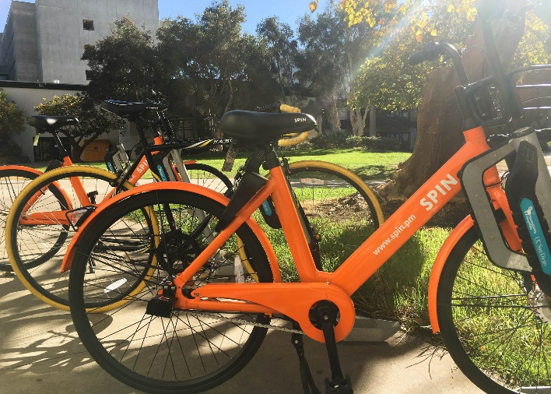
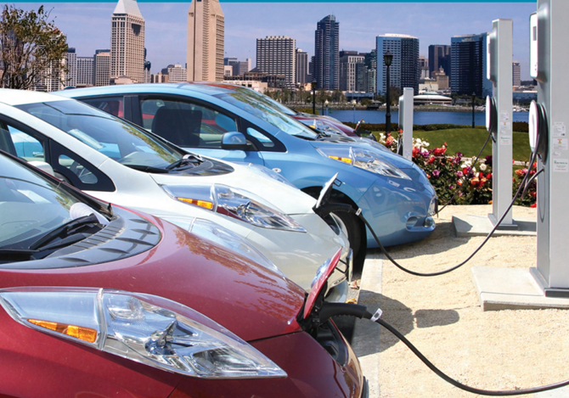
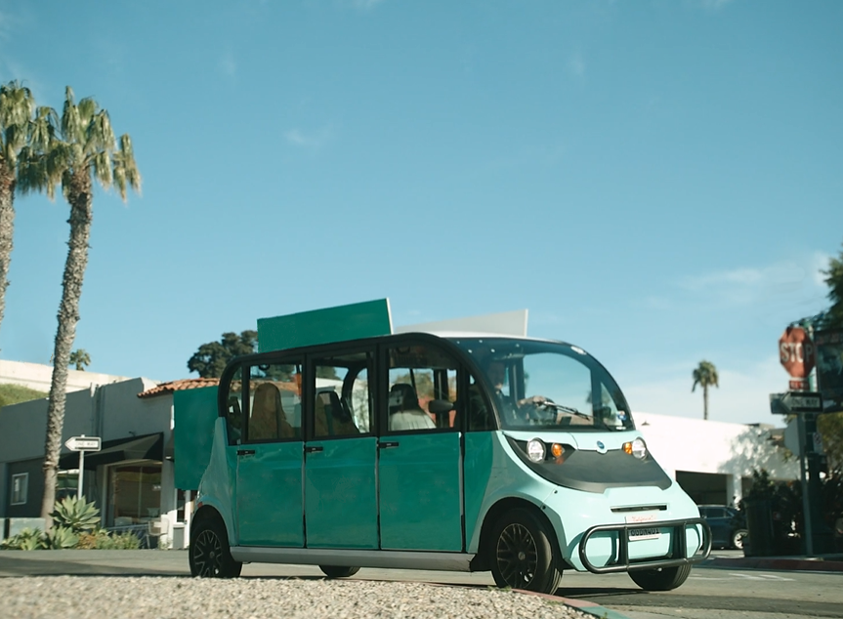
Shifting Away from a Car-Centric System
Notes:
Challenges & complexities with bike/ped conflict and tradeoffs
Important considerations for mobility moving forward:
Accessibility
safety
Equity
Partnership
Reducing congestion

Slide 4
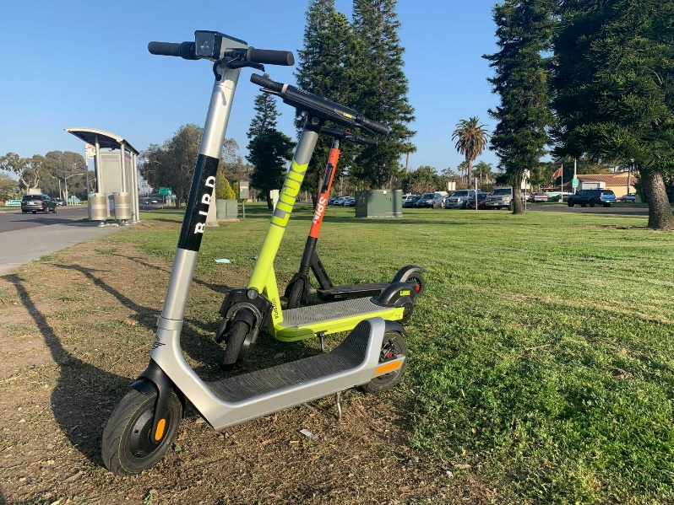
Shared Mobility Device Program 2.0
Adopted by City Council July 2022
Transitioned from a Permit model to a Contract model
5-year term
Two to four operators​
8,000 devices maximum Citywide (scooters and bikes)​
Data management
Focused equity programming
Established a mechanism for ongoing public feedback
Notes:
Our 2022 climate action plan sets a net zero greenhouse gas emissions goal for 2035.
We have also set an interim 2030 goal to achieve our fair share of reductions, solidifying the City’s commitment to joining the global effort to address climate change.
Robust community input has laid the foundation for this plan, we have heard from over 4,000 residents throughout our engagement, their voices are reflected through our choices for actions and how we prioritized the core benefits of climate action like air quality and green jobs.
We used an assessment tool to analyze the feasibility & potential for equitable impact of every action as well as how it would impact the daily lives of San Diegans. This works builds the foundation for implementation.
Lastly, this update to the CAP will maintain the CEQA streamlining process that has been a part of the City’s CAP since 2015.

Slide 5
New SMD Regulations
Define Shared Dockless Mobility Devices
Standardized contract terms
Age verification requirements ​
One shared mobility device per person​
Prohibition of parking / riding on all City sidewalks​
Prohibition of parking devices outside of a corral
Reduction of operator response time from 3-hours to 1-hour​
Technology Requirements
Geofencing
Sidewalk detection
MDS data feed
Notes:
utility in regulations and process (public input & market sounding on feasibility)

Slide 6
Performance to Date (August 1 – December 31, 2022)
371,520 trips
Average trip duration ~13 mins
Average trip distance 1.05 miles
~22,025 - 30,285 tons of CO2 reduced
Notes:
SMD Data for the period of August 1st 2022 to December 31st 2022
# Trips
371,520
Total Trips Distance
343,900 mi
Total Trips Duration
4,393,028 mins
Avg Trip Distance
1.05 mi
Avg Trip Duration
13 mins 20 secs
CO2 Savings
22,025 - 30,285 t-CO2eq

Slide 7
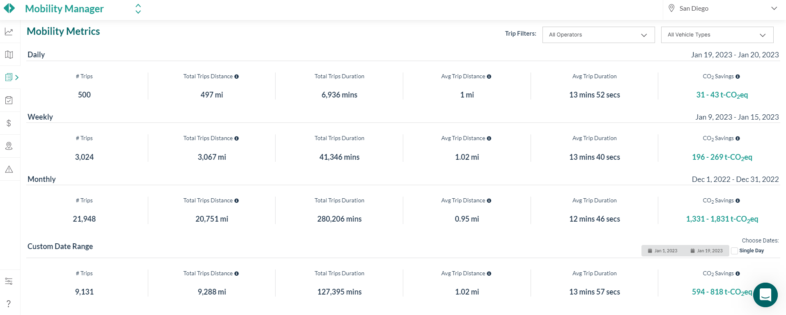
Performance Monitoring
Notes:
SMD Data for the period of August 1st 2022 to December 31st 2022
# Trips
371,520
Total Trips Distance
343,900 mi
Total Trips Duration
4,393,028 mins
Avg Trip Distance
1.05 mi
Avg Trip Duration
13 mins 20 secs
CO2 Savings
22,025 - 30,285 t-CO2eq

Slide 8
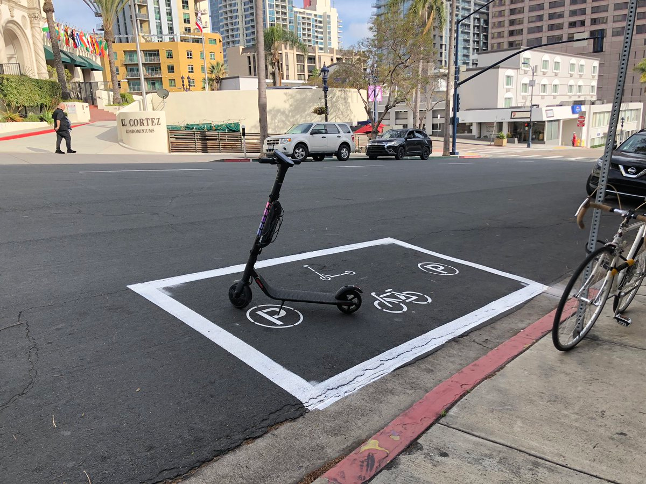
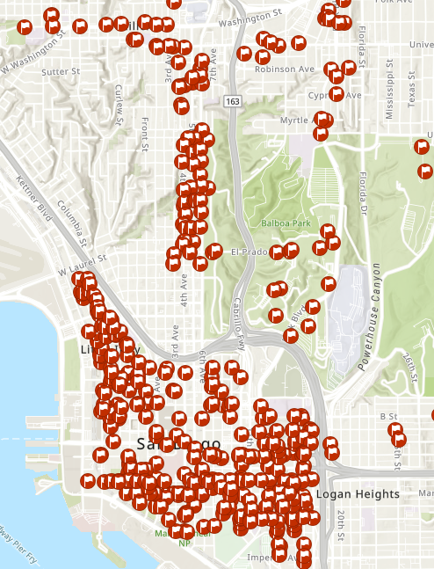
Building Shared Mobility for Success
Supportive infrastructure
770 shared mobility corrals city-wide
Focused expansion
Complement bike facilities
Disadvantaged communities
Balancing enforcement
Continued program monitoring and improvements
Notes:
Our 2022 climate action plan sets a net zero greenhouse gas emissions goal for 2035.
We have also set an interim 2030 goal to achieve our fair share of reductions, solidifying the City’s commitment to joining the global effort to address climate change.
Robust community input has laid the foundation for this plan, we have heard from over 4,000 residents throughout our engagement, their voices are reflected through our choices for actions and how we prioritized the core benefits of climate action like air quality and green jobs.
We used an assessment tool to analyze the feasibility & potential for equitable impact of every action as well as how it would impact the daily lives of San Diegans. This works builds the foundation for implementation.
Lastly, this update to the CAP will maintain the CEQA streamlining process that has been a part of the City’s CAP since 2015.

Slide 9
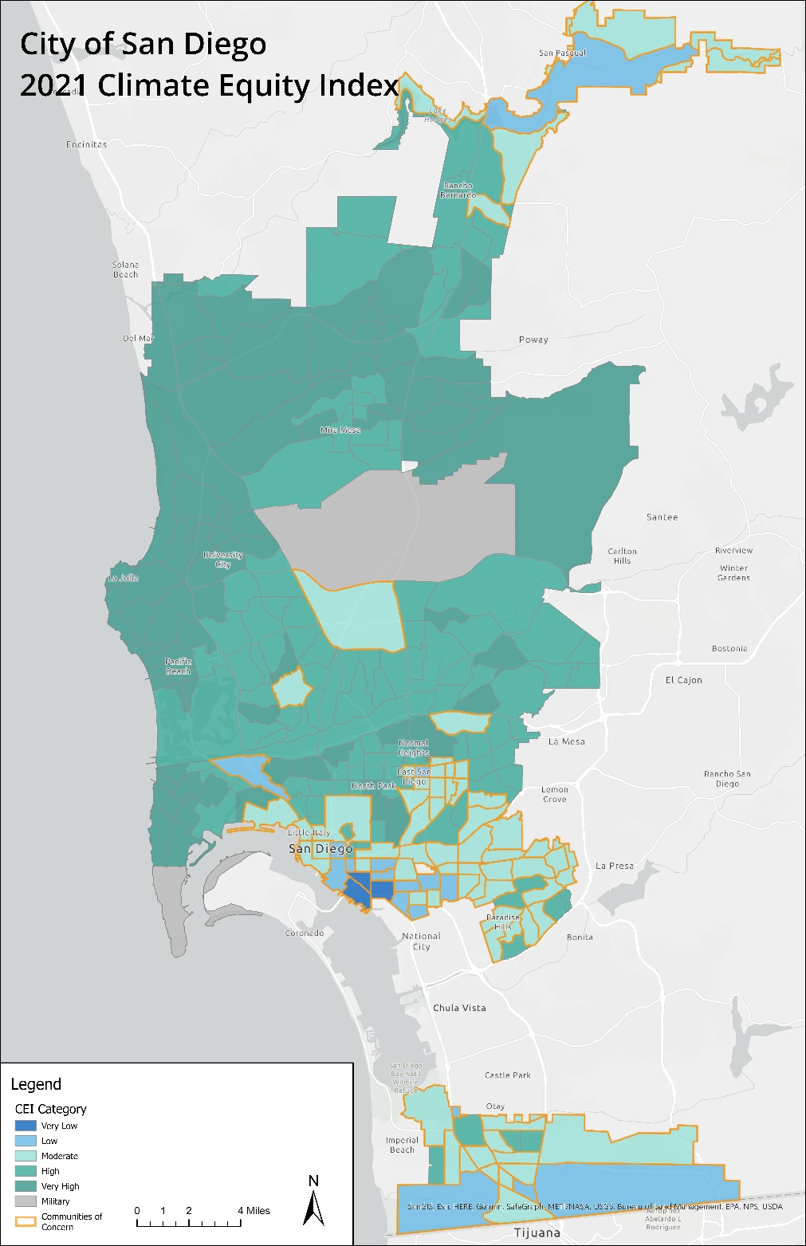
Advancing Sustainable Mobility
Climate Equity
Safety
Access
Mode shift
Infrastructure
Partnership
Notes:
Safety
Access – first/last mile
Mode shift – trip information
Infrastructure – maximizing ROW space
Partnership – public, private

Slide 10
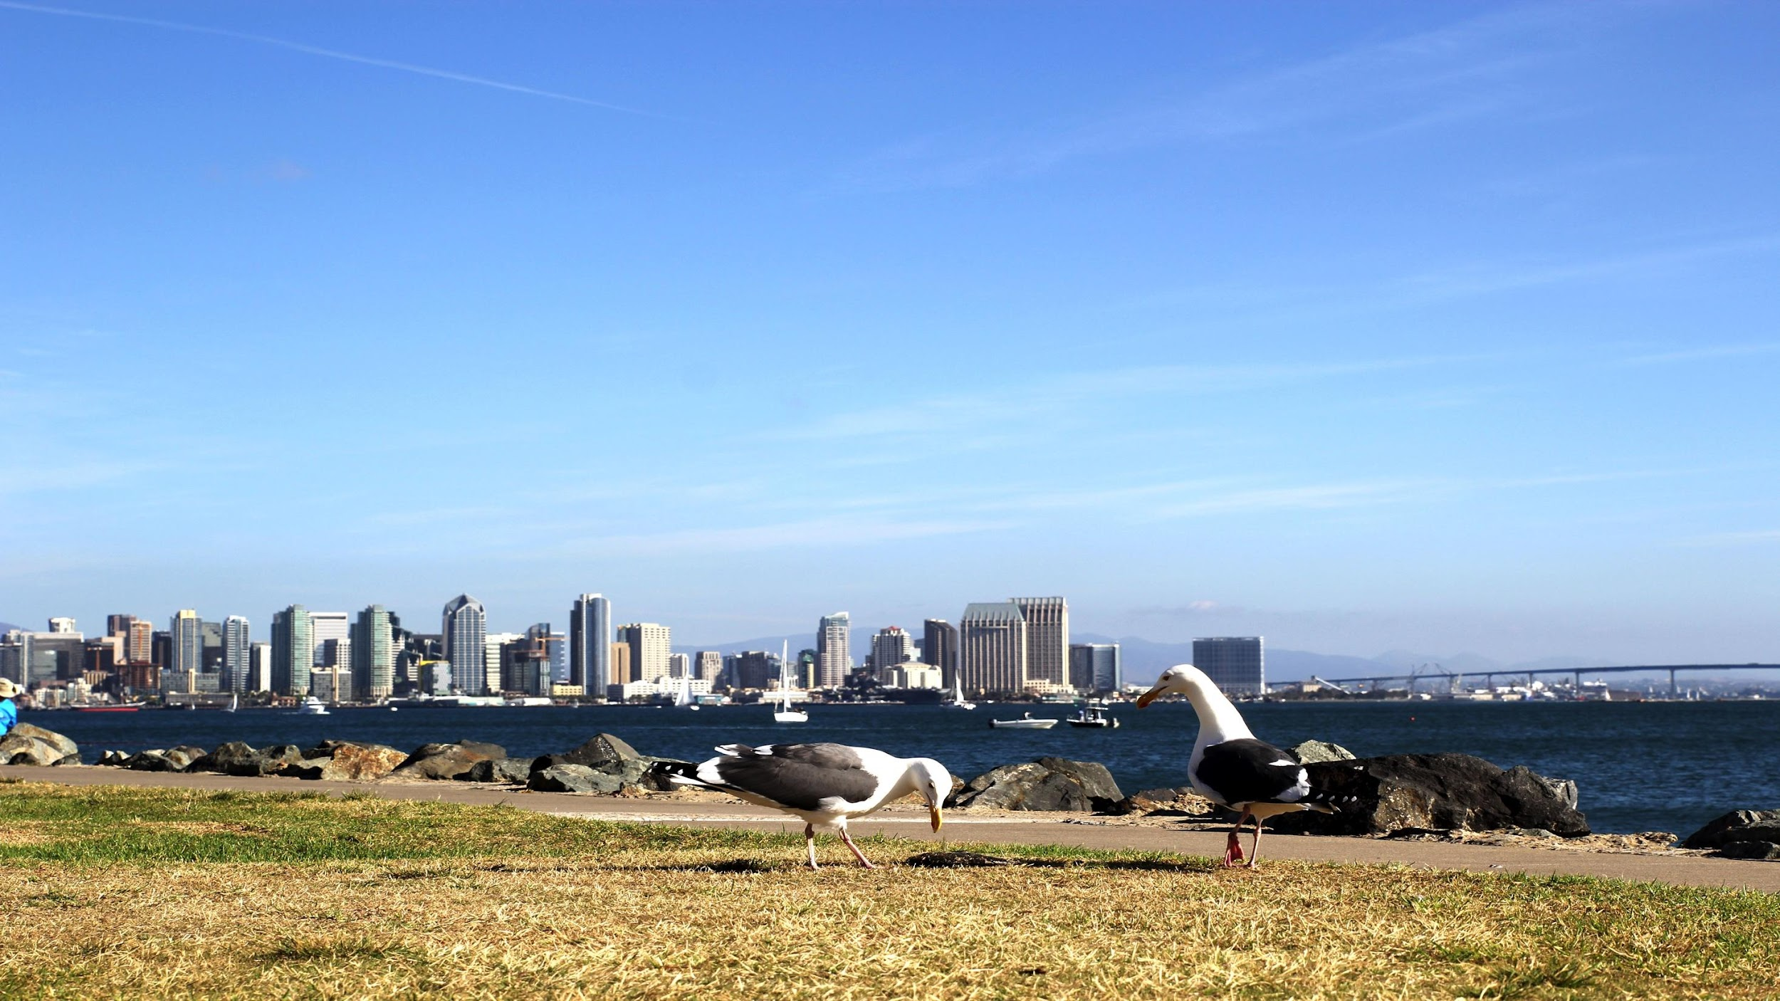
More questions?
sustainability@sandiego.gov
Stay engaged at:
sandiego.gov/sustainability

